Slide 1



Computing Local TAD Similarity in Hi-C data
Gabriel Fonseca, Simon Chow, Sumitra
Lele
Notes:
This is an ugly color will change it later

Slide 2
Contents
Objectives
What is 3D Genomics?
Why Hi-C data?
What are TADs? Why are they important?
How do we computationally identify them?
Methods:
LocalTADSim
TADCompare
Results/Comparisons
Conclusions
Future Work

Slide 3
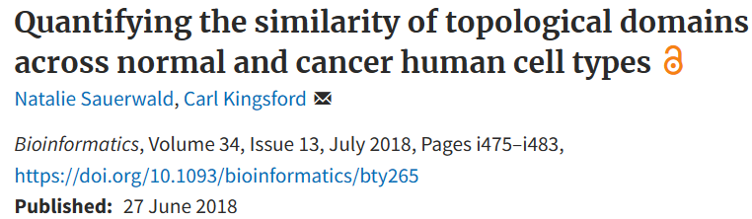

Objectives
Follow Kingsford Lab’s implementation of Local Tad Sim
Compare the TAD analysis results with other packages
TADCompare, Spectral TAD, CoolTools

Slide 4
What is 3D Genomics?
With 3D Genomes we understand how chromatin conformation is regulating genes.
In a multi-omics approach, it helps us piece together the information from different modalities.
Technology | Transcriptomics | Epigenomics | 3D Genomics
Data | Quantified gene expression | Non-Sequence state (histone acetylation, etc) | Interaction between different regions of the chromatin
Question | Is there differential expression? | Does the chromatin state correlate with expression? | Why is there differential expression in the first place?
CAUSE
Notes:
We have the DNA sequence, we know the non-sequence modifications for epigenetic assays, we have the transcriptomic information to quantify the expression, we have the proteomic and metabolomic assays to tell us what is happening at the cellular level, but do we know why the gene expression is the way it is? No.
The gene conformation change has altered the compartments of the chromatin → hence promoter X is interacting with enhancer Y, causing the change in the expression of gene A

Slide 5
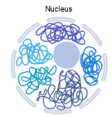
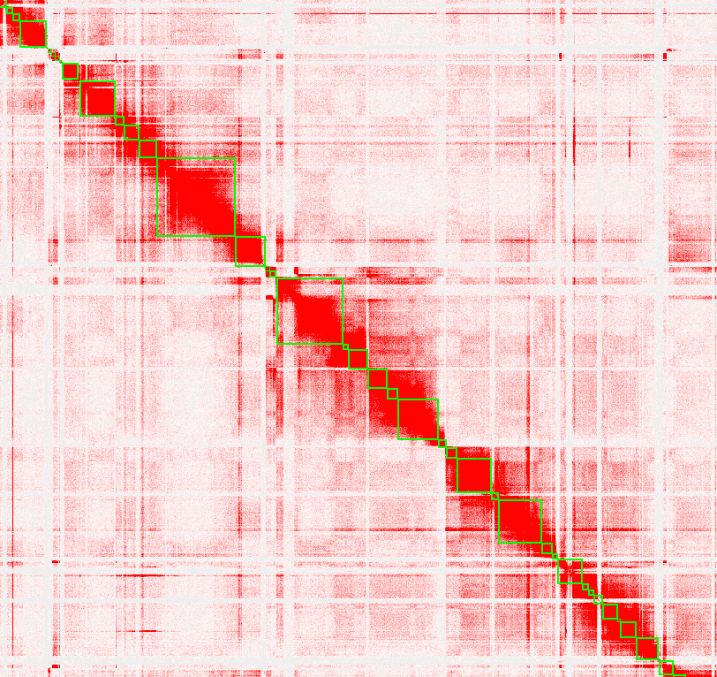
What is Hi-C Data? What is the output?
Outputs:
X | Y | Contact
6000 | 7000 | 12238
5000 | 5000 | 372929
….. | ….. | …..

Slide 6
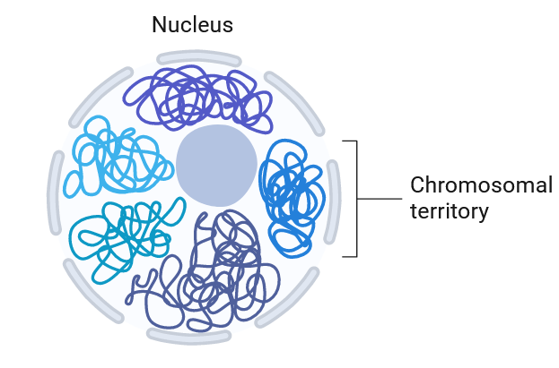
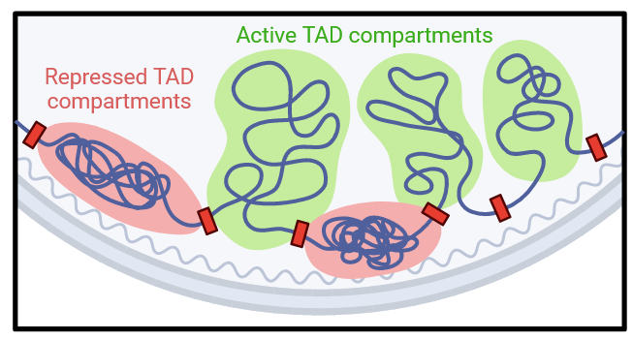
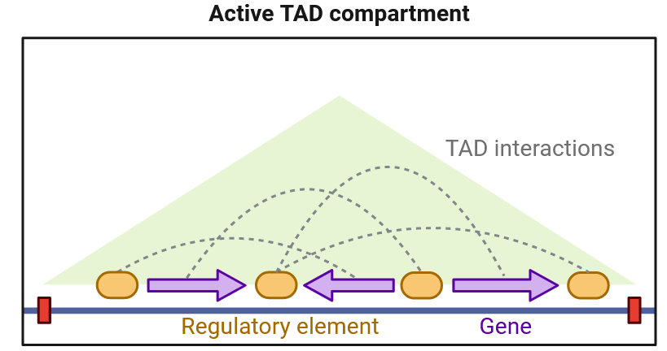
What are TADs? Why are they important?
TAD = Topologically Associating Domain

Slide 7
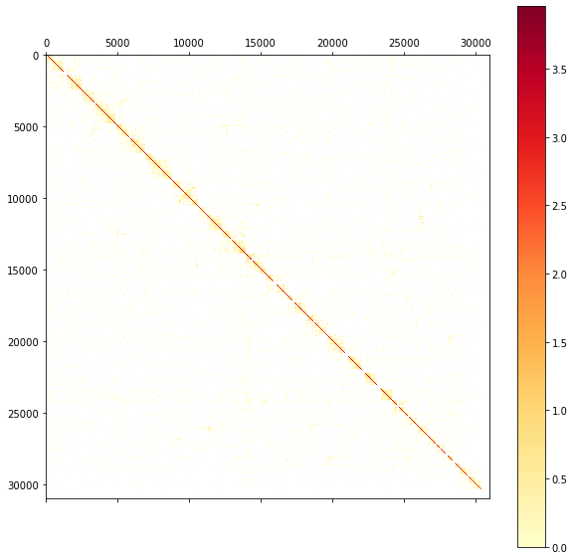
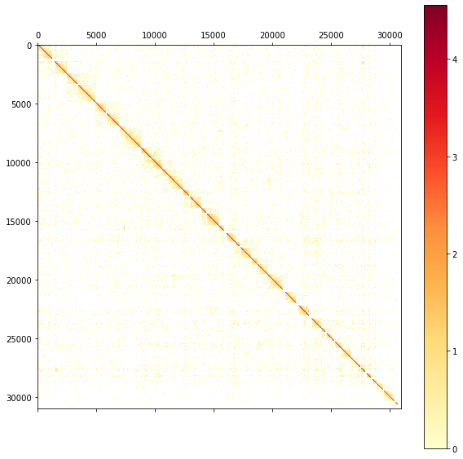
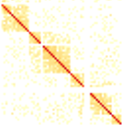
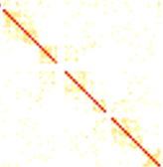
Hi-C Contact Maps
Control
Condition

Slide 8
How are TADs identified computationally?
TAD Calling Problem:
Input: A contact matrix ContactMatrix, where ContactMatrix[ i ][ j ] is a float representing the amount of interaction between genomic positions i and j.
Output: A list of integers TADBoundaries representing the genomic positions where the amount of contact is locally minimized.
Can be thought of as a one dimensional clustering
Need a way to quantify local similarity
Many methods are possible
Notes:
Literature Review - TAD Calling

Slide 9
Solving the TAD Calling problem
Hidden Markov Models
Spectral TAD
States define if still in the same TAD or transition to another
Can use genomic background information for parameters
Uses a Laplacian matrix to locate regions of significant difference.
Spectral decomposition (eigenvalue decomposition)
Input: contact matrices -> Output: TAD coordinates (BED File)

Slide 10
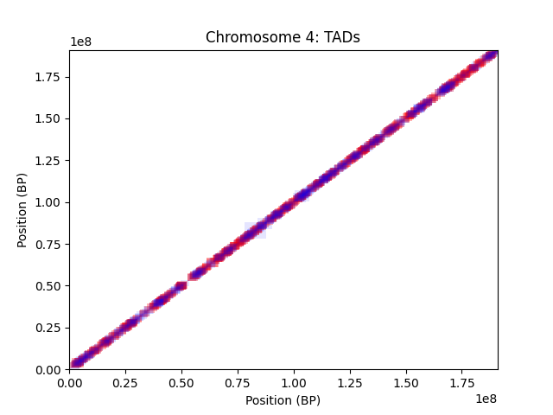
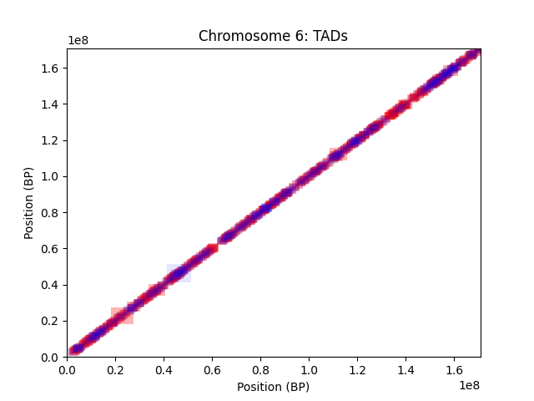
TAD Plots (from SpectralTAD)
*Shape sizes magnified 40x for visibility
Control
Condition
*Sizes are 10x for visibility

Slide 11
How are TADs compared?
Once we find TADs, want to know if they are significantly different across conditions
Comparing across TADs lowers computational complexity to only the boundaries, and lowers variability in the analysis
Leads us to a new computational problem:
TAD Comparison Problem:
Input: A list of integers TADBoundariesControl and TADBoundariesExperimental representing the genomic locations separating TADs from a control sample and from an experimental sample.
Output: A list of floats DifferentialContact, where DifferentialContact[ i ] represents the similarity between TAD boundaries from TADBoundariesControl and TADBoundariesExperimental at genomic position i.

Slide 12
Methods - How do we actually assess ‘contact similarity’?
There are multiple different ways of looking at TAD similarity:
TADCompare
Graph representation of the interaction matrix
The contact/interaction matrix shows us the quantified contact between region ‘i’ and region ‘j’
This can essentially be looked at as a graph adjacency matrix, where the edges are the contacts with weights as the quantified contact and the vertices as the regions on the genome.
LocalTADSim
Compute conditional entropy of each clustering
Use TAD boundaries within larger boundaries to asses the difference between TADs and overall chromosome
Notes:
Literature Review - TAD Comparison

Slide 13
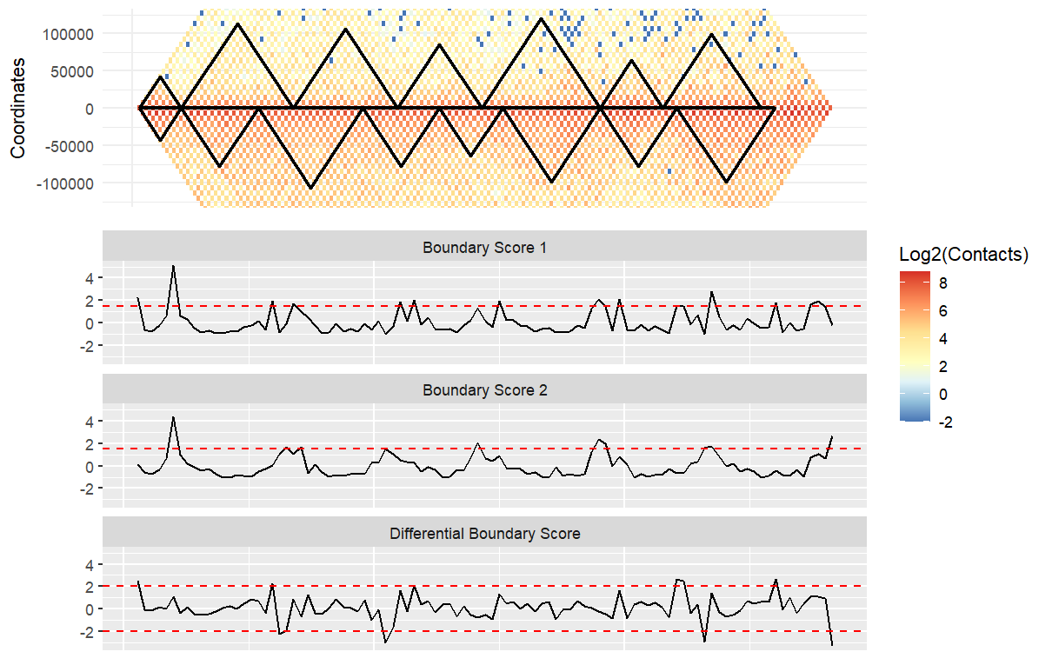
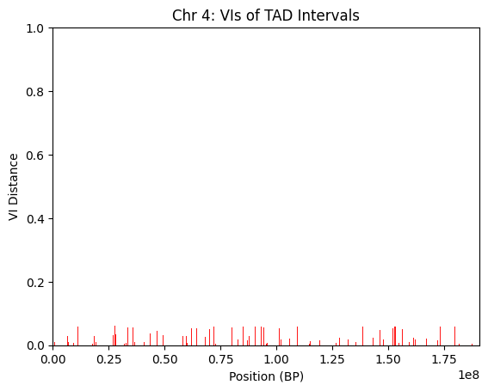
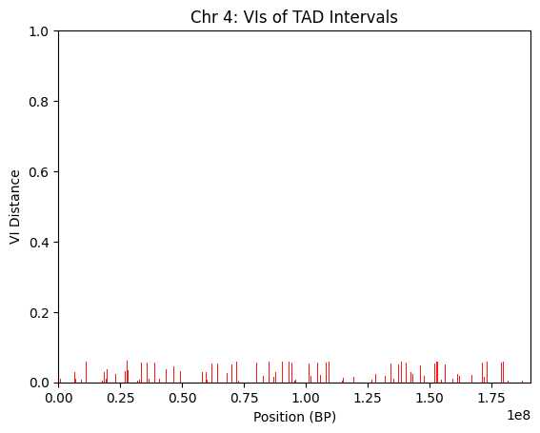
Results - TADCompare
Chromosome 4

Slide 14
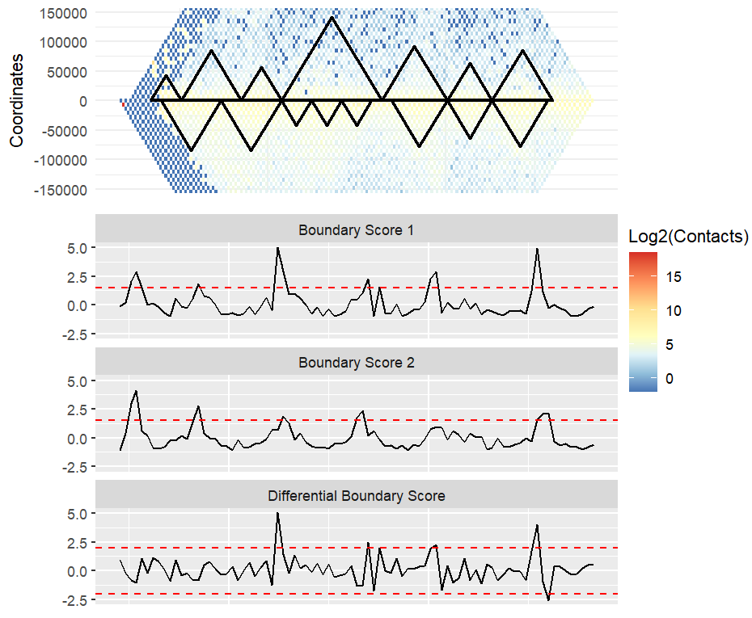
Results - TADCompare
Chromosome 6

Slide 15
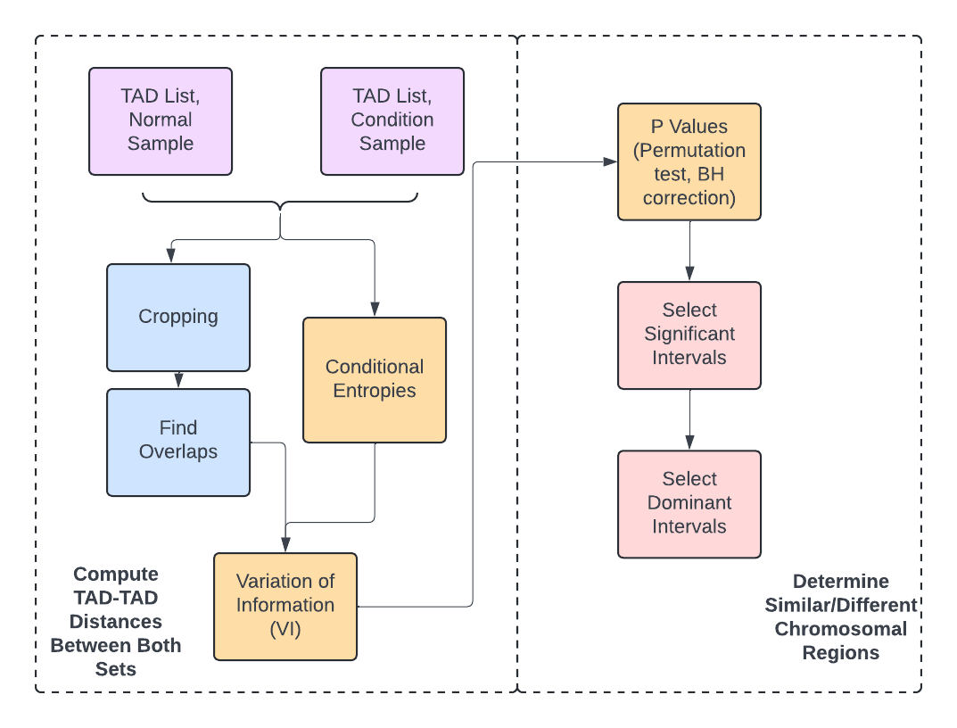
LocalTADSim implementation - Workflow

Slide 16




TADSim - Computing Conditional Entropy and VI
Entropy
Each C contains sub clusters (smaller TAD boundaries)
VI between clusters in different samples ~ normalized sum of their entropies
VI serves as distance matrix
Variation of Info (VI)
Source: ¹Natalie Sauerwald, Carl Kingsford, Quantifying the similarity of topological domains across normal and cancer human cell types, Bioinformatics, Volume 34, Issue 13, July 2018, Pages i475–i483, https://doi.org/10.1093/bioinformatics/bty265

Slide 17
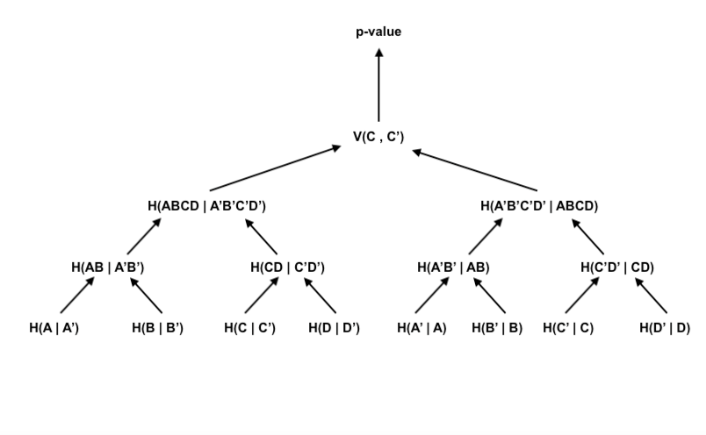
Conditional Entropy via Dynamic Programming
Since the conditional entropy requires information about sub clusters, can avoid recomputing values
Each internal node gives a p-value for sub-clusters
Computation graph of DP recurrence

Slide 18
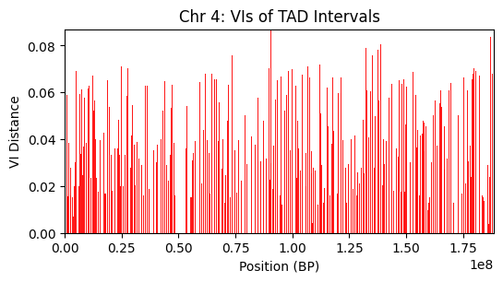
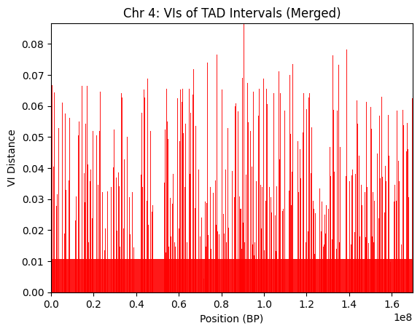
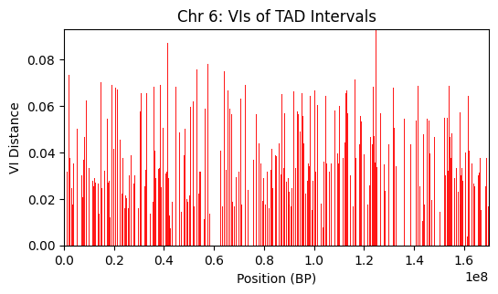
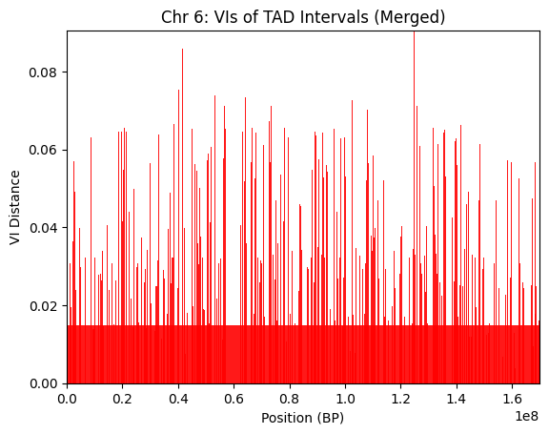
TADSim: VIs of TAD Intervals
2,536 tads
1,783 tads
2,220 tads
1,545 tads

Slide 19
Conclusion
Can employ various TAD calling and comparison techniques to assess chromosomal regional similarities
Benefits of each TAD comparison method
Spectral TAD: versatility with reading Hi-C matrices; output coords can work with many downstream analyses & plots
TADCompare’s plots highlight TAD boundaries, contact heatmap and chromosome structure concisely & effectively
LocalTADSim: strong balance between speed & accuracy; robust statistics for region selection

Slide 20
Future Work
Produce the TAD comparison data across all other chromosomes
Finish LocalTADSim pipeline
Finalize VI dynamic programming
Compute p-values
Find significant & dominating intervals
Understand how we can validate our findings with downstream analysis

Slide 21
References
¹Natalie Sauerwald, Carl Kingsford, Quantifying the similarity of topological domains across normal and cancer human cell types, Bioinformatics, Volume 34, Issue 13, July 2018, Pages i475–i483, https://doi.org/10.1093/bioinformatics/bty265
https://hicexplorer-gtrichard.readthedocs.io/
https://github.com/dozmorovlab/TADCompare/
https://github.com/open2c/cooltools
https://bioconductor.org/packages/release/bioc/html/SpectralTAD.html
SpectralTAD: an R package for defining a hierarchy of topologically associated domains using spectral clustering | BMC Bioinformatics | Full Text (biomedcentral.com)

Slide 22
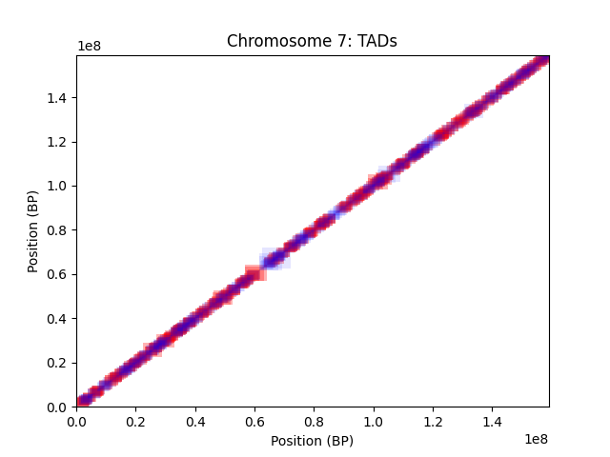
Closer Look
*Shape sizes magnified 40x for visibility
Control
Condition

Slide 23
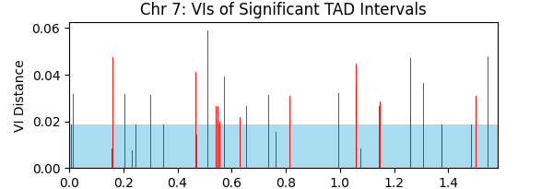
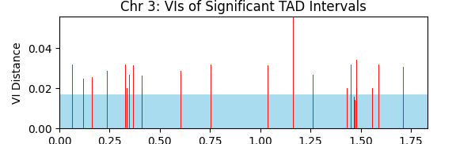
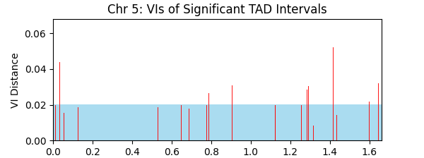
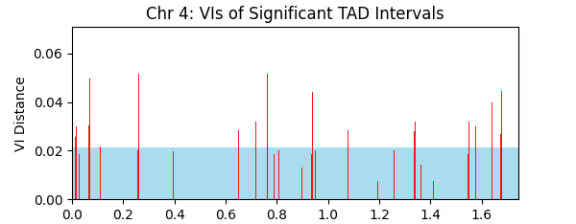
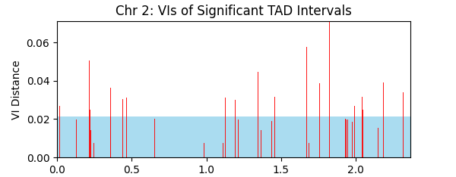
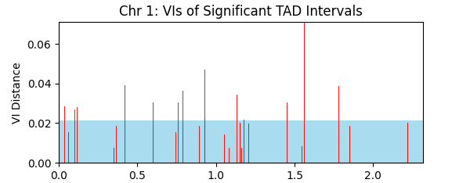

Slide 24
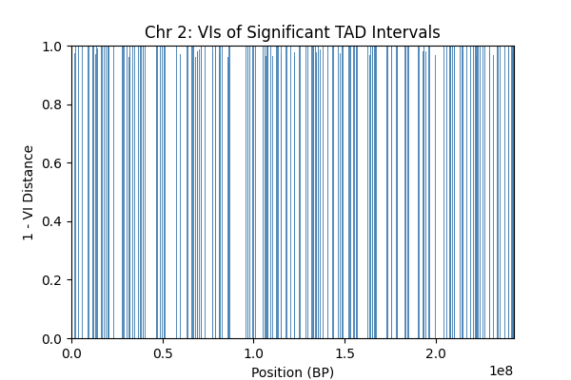
TADSim - Results

Slide 25
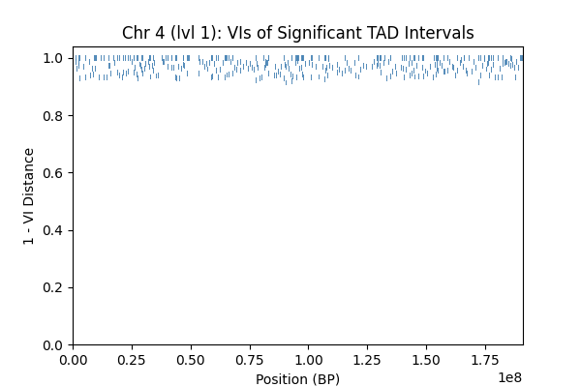
Significant Intervals

Slide 26
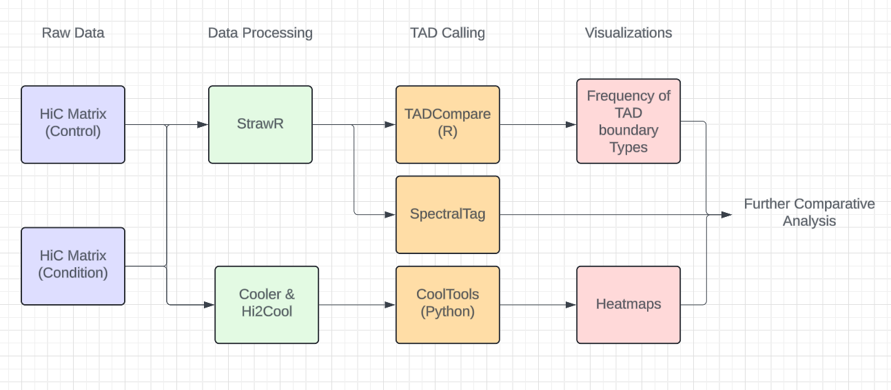
Main Workflow

